Slide 1
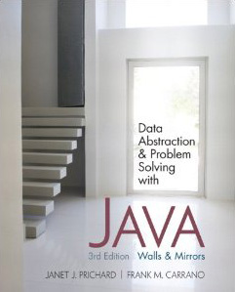
Chapter 9
Advanced Java Topics
© 2011 Pearson Addison-Wesley. All rights reserved
9 A-<number>

Slide 2
Inheritance Revisited
Inheritance
  Allows a class to derive the behavior and structure of an existing class
© 2011 Pearson Addison-Wesley. All rights reserved
9 A-<number>

Slide 3
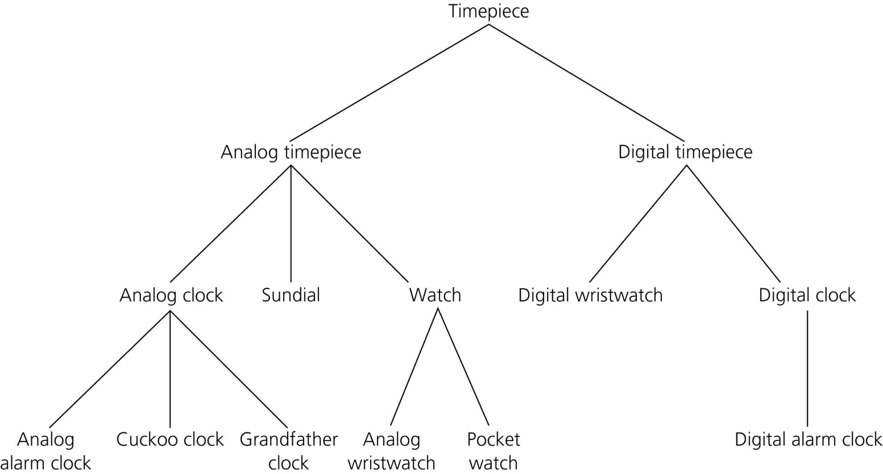
Inheritance Revisited
Figure 9-1
Inheritance: Relationships among timepieces
© 2011 Pearson Addison-Wesley. All rights reserved
9 A-<number>

Slide 4
Inheritance Revisited
Superclass or base class
  A class from which another class is derived
Subclass, derived class, or descendant class
  A class that inherits the members of another class
Benefits of inheritance
  It enables the reuse of existing classes
  It reduces the effort necessary to add features to an existing object
© 2011 Pearson Addison-Wesley. All rights reserved
9 A-<number>

Slide 5
Inheritance Revisited
A subclass
  Can add new members to those it inherits
  Can override an inherited method of its superclass
    A method in a subclass overrides a method in the superclass if the two methods have the same declarations
© 2011 Pearson Addison-Wesley. All rights reserved
9 A-<number>

Slide 6
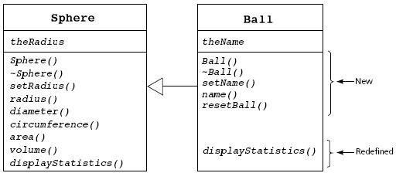
Inheritance Revisited
Figure 9-2
The subclass Ball inherits members of the superclass Sphere and overrides and adds methods
© 2011 Pearson Addison-Wesley. All rights reserved
9 A-<number>

Slide 7
Inheritance Revisited
A subclass inherits private members from the superclass, but cannot access them directly
Methods of a subclass can call the superclass’s public methods
Clients of a subclass can invoke the superclass’s public methods
An overridden method
  Instances of the subclass will use the new method
  Instances of the superclass will use the original method
© 2011 Pearson Addison-Wesley. All rights reserved
9 A-<number>

Slide 8
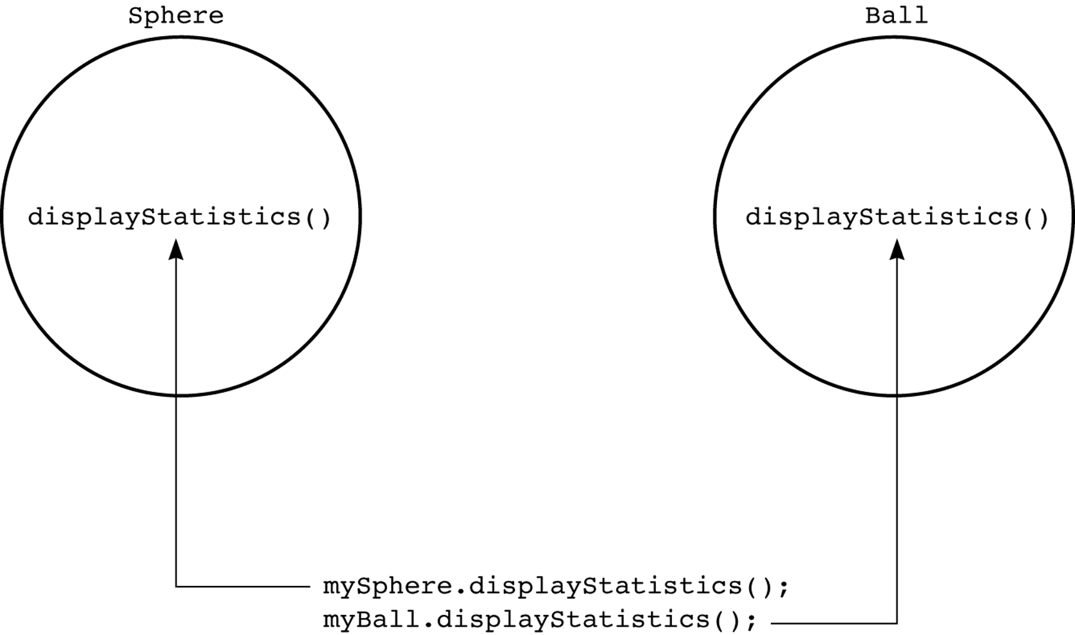
Inheritance Revisited
Figure 9-3
An object invokes the correct version of a method
© 2011 Pearson Addison-Wesley. All rights reserved
9 A-<number>

Slide 9
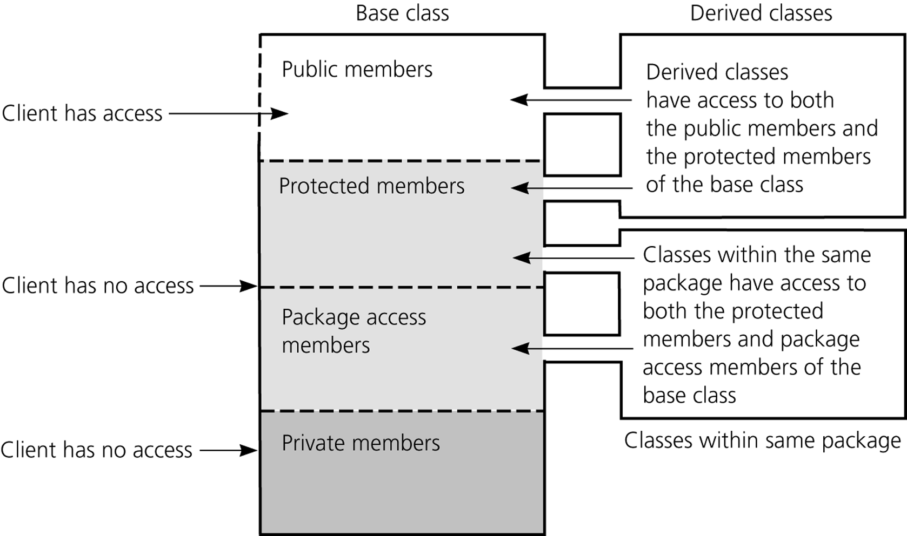
Java Access Modifiers
Figure 9-4
Access to public, protected, package access, and private members of a class by a client and a subclass
© 2011 Pearson Addison-Wesley. All rights reserved
9 A-<number>

Slide 10
Java Access Modifiers
Membership categories of a class
  Public members can be used by anyone
  Members declared without an access modifier (the default) are available to
    Methods of the class
    Methods of other classes in the same package
  Private members can be used only by methods of the class
  Protected members can be used only by
    Methods of the class
    Methods of other classes in the same package
    Methods of the subclass
© 2011 Pearson Addison-Wesley. All rights reserved
9 A-<number>

Slide 11
Is-a and Has-a Relationships
Two basic kinds of relationships
  Is-a relationship
  Has-a relationship
© 2011 Pearson Addison-Wesley. All rights reserved
9 A-<number>

Slide 12

Is-a Relationship
Inheritance should imply an is-a relationship between the superclass and the subclass
Example:
  If the class Ball is derived from the class Sphere
    A ball is a sphere
Figure 9-5
A ball “is a” sphere
© 2011 Pearson Addison-Wesley. All rights reserved
9 A-<number>

Slide 13
Is-a Relationship
Object type compatibility
  An instance of a subclass can be used instead of an instance of the superclass, but not the other way around
© 2011 Pearson Addison-Wesley. All rights reserved
9 A-<number>

Slide 14
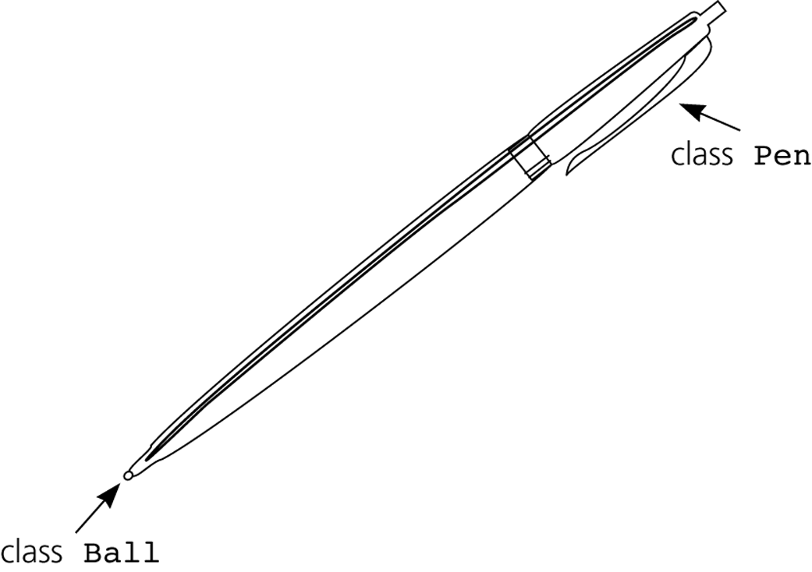
Has-a Relationships
Figure 9-6
A pen “has a” or “contains a” ball
© 2011 Pearson Addison-Wesley. All rights reserved
9 A-<number>

Slide 15
Has-a Relationships
Has-a relationship
  Also called containment
  Cannot be implemented using inheritance
    Example: To implement the has-a relationship between a pen and a ball
      Define a data field point – whose type is Ball – within the class Pen
© 2011 Pearson Addison-Wesley. All rights reserved
9 A-<number>

Slide 16
Dynamic Binding and Abstract Classes
A polymorphic method
  A method that has multiple meanings
  Created when a subclass overrides a method of the superclass
Late binding or dynamic binding
  The appropriate version of a polymorphic method is decided at execution time
© 2011 Pearson Addison-Wesley. All rights reserved
9 A-<number>

Slide 17
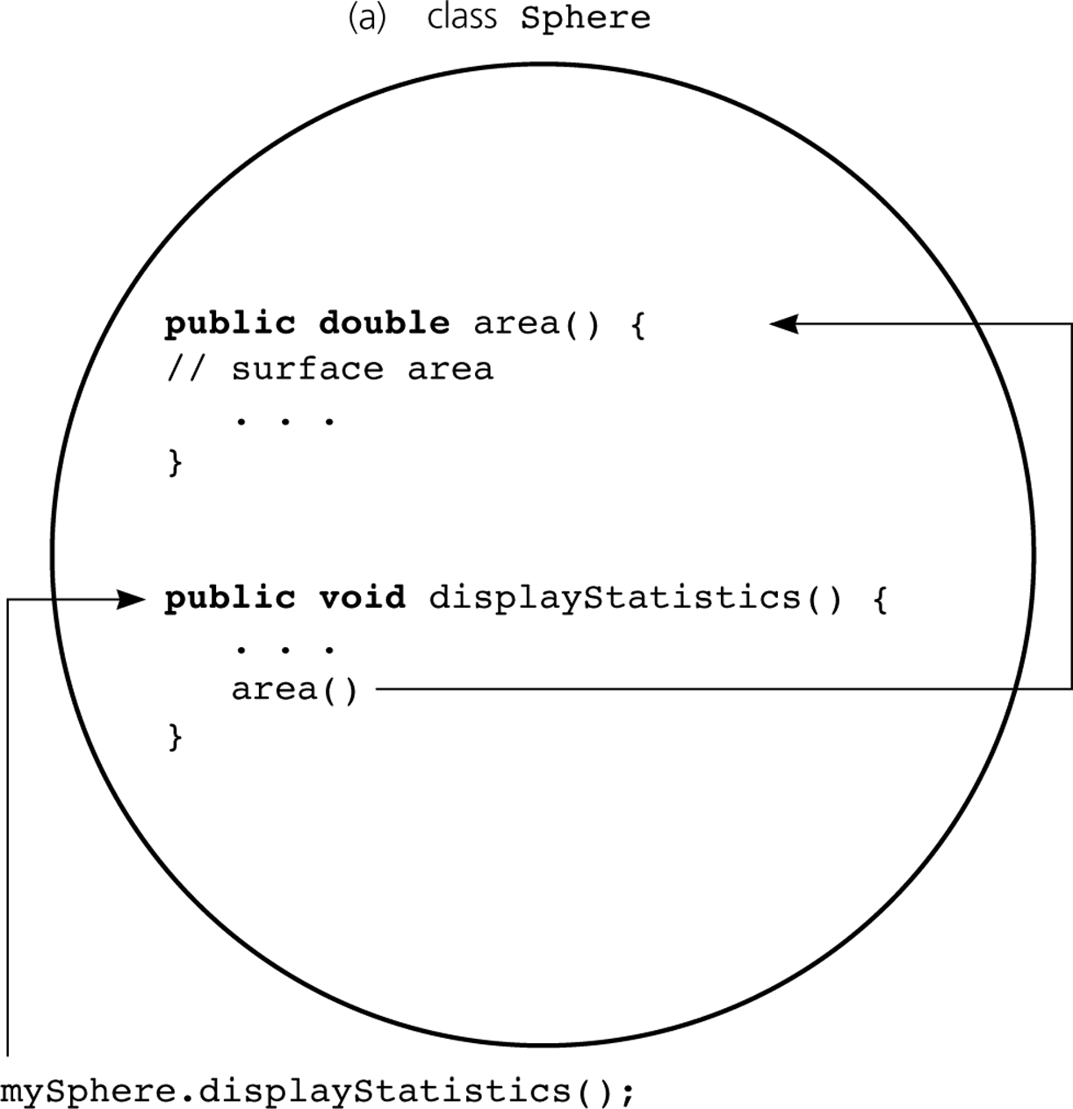
Dynamic Binding and Abstract Classes
Figure 9-7a
area is overridden: a) mySphere.DisplayStatistics( ) calls area in Sphere
© 2011 Pearson Addison-Wesley. All rights reserved
9 A-<number>

Slide 18
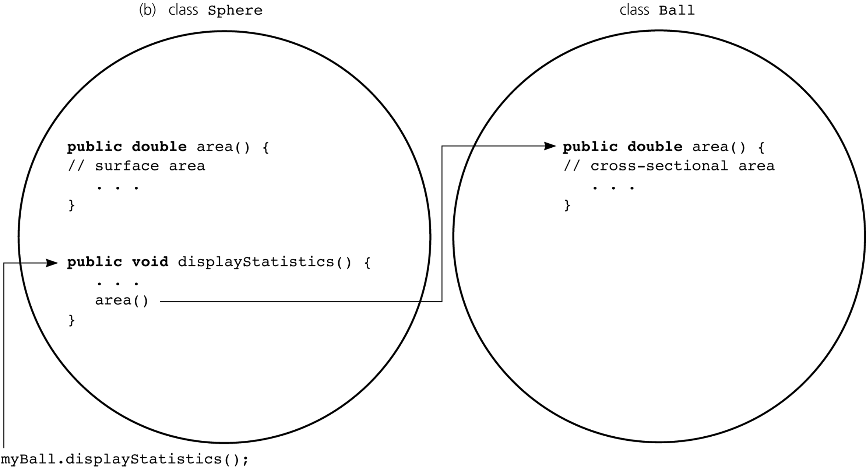
Dynamic Binding and Abstract Classes
Figure 9-7b
area is overridden: b) myBall.displayStatistics( ) calls area in Ball
© 2011 Pearson Addison-Wesley. All rights reserved
9 A-<number>

Slide 19
Dynamic Binding and Abstract Classes
Controlling whether a subclass can override a superclass method
  Field modifier final
    Prevents a method from being overridden by a subclass
  Field modifier abstract
    Requires the subclass to override the method
Early binding or static binding
  The appropriate version of a method is decided at compilation time
  Used by methods that are final or static
© 2011 Pearson Addison-Wesley. All rights reserved
9 A-<number>

Slide 20
Dynamic Binding and Abstract Classes
Overloading methods
  To overload a method is to define another method with the same name but with a different set of parameters
  The arguments in each version of an overloaded method determine which version of the method will be used
© 2011 Pearson Addison-Wesley. All rights reserved
9 A-<number>

Slide 21
Please open file carrano_ppt09_B.ppt
to continue viewing chapter 9.
© 2011 Pearson Addison-Wesley. All rights reserved
9 A-<number>

